Slide 1
Design Forum
E2E Metamodel Working Group
example

Slide 2
E2E Metamodel
Context – Provides additional context (typically needed with hierarchy, time…)
E2E Federation Level – Specifies E2E Federation Level (L0, L1, L2, L3, L4)
Operational Activity – What does the department do (aka function, high level “collapsed process”)
ActivityInE2EContext – an activity employed within a specific E2E
BPMN Task – an activity representing a task in a BPMN process model
E2E Segment – A capability to achieve a desired outcome through a combination of ways and means
BPMN Segment – an E2E Segment that is represented by a BPMN process model
DM2: Property
DM2: Capability
DM2: Activity
isScopedBy
Context
isScopedBy
E2E Segment
enables
asFunctionallyAligned
Operational
Activity
IsLevelFor
isPartOf
isPartOf
BPMN
Segment
ActivityInE2EContext
BPMN Task
E2E Federation Level
isMoreDetailed
L0
L1
L2
L3
L4

Slide 3
Notional Example: E2E Plan to Stock
Level 0
Plan to Stock
Level 1
Create Inventory Plan
Determine Source
Receive, Accept and Warehouse Inventory
Receive Goods and Services
Accept Goods and Services
Level 2
E2E Segment corresponding to an Operational Activity from the BEA activity node tree
Accept Goods and Services BPMN
E2E Segment represented by a BPMN model (BPMN Segment):
Illustrated here as a BEA ‘level 2 extension’, but …
could also be a Component level 3 operational process model

Slide 4
Notional Example: E2E Procure to Pay
Level 0
Procure to Pay
Level 1
Award Procurement Instrument
Administer Procurement Instrument
Perform Receipt, Acceptance and Return
Accept Goods and Services
Level 2
E2E Segment also corresponding to an Operational Activity from the BEA activity node tree
Participates in Two E2E Hierarchies: P2S and P2P

Slide 5
Notional Example: E2E Acquire to Retire
Level 0
Acquire to Retire
Level 1
Concept to Product
Procure to Pay
Placement into Service
Level 2
Participates in Two E2E Hierarchies: A2R and P2P

Slide 6
‘Nested’ E2E Hierarchies and Federation Level
Level 0
Acquire to Retire
Concept to Product
Procure to Pay
Placement into Service
Level 1
Award Procurement Instrument
Administer Procurement Instrument
Perform Receipt, Acceptance and Return
Level 2
Accept Goods and Services
BEA E2E Hierarchy ‘leaves’ always understood as Level 2

Slide 7
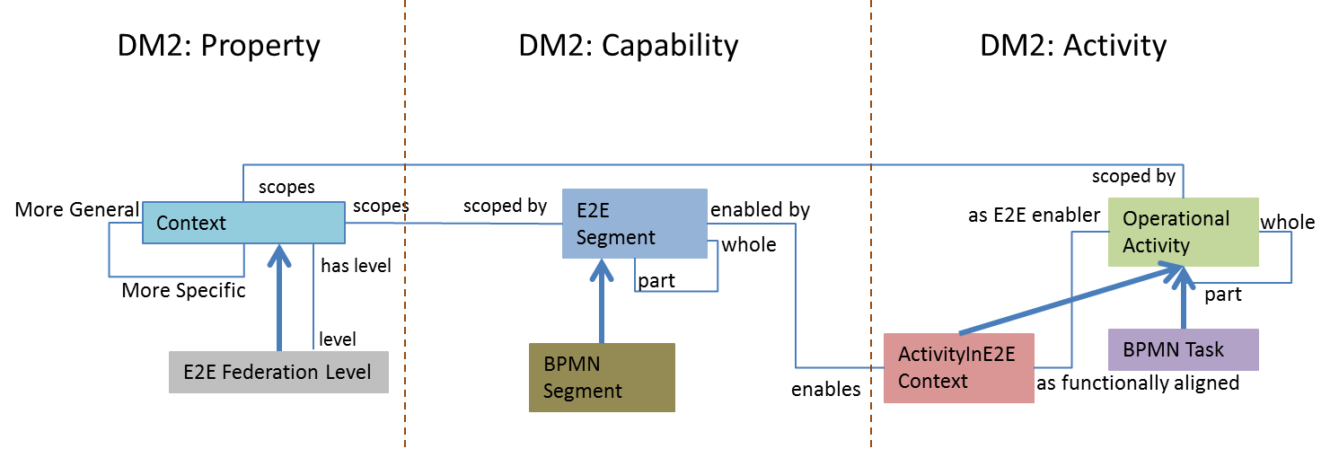
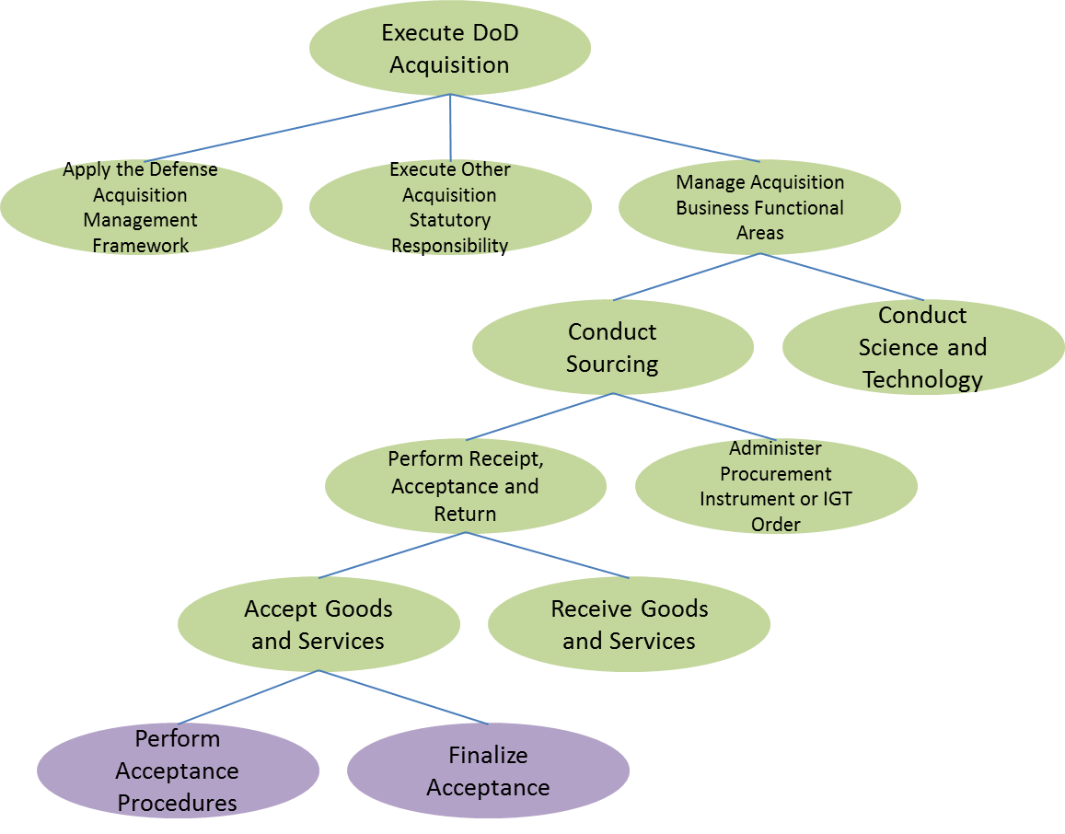
Architecture Model Notional Example: BEA Operational Activity Node Tree
Meta-Model
Architecture Models
Functional Activity Hierarchy

Slide 8
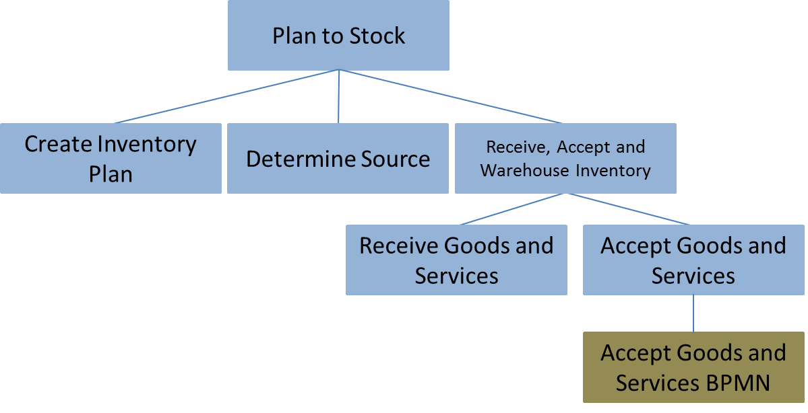
Architecture Model Notional Example: E2E Hierarchy: P2S
Meta-Model
Architecture Models
E2E Capability Hierarchies
Functional Activity Hierarchy
E2E Hierarchy: P2S

Slide 9




Architecture Model Notional Example: E2E Hierarchy and Federation Level Context
Meta-Model
Architecture Models
E2E Capability Hierarchies
Functional Activity Hierarchy
P2S E2E Hierarchy Context
P2S L0 E2E Federation Level
P2S L1 E2E Federation Level
P2S L2 E2E Federation Level

Slide 10

Architecture Model Notional Example: Operational Activity in E2E Context
Meta-Model
Architecture Models
E2E Capability Hierarchies
Functional Activity Hierarchy
Activity in E2E Context: P2S L2

Slide 11
Architecture Model Notional Example: BPMN Tasks Extend the BEA Activity Node Tree
Meta-Model
Architecture Models
E2E Capability Hierarchies
Functional Activity Hierarchy
Task within the BPMN model

Slide 12
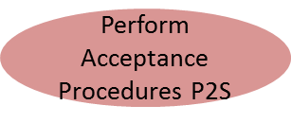
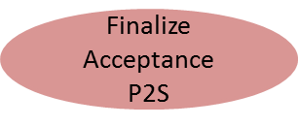
Architecture Model Notional Example: BPMN Task in E2E Context
Meta-Model
Architecture Models
E2E Capability Hierarchies
Functional Activity Hierarchy
Task in E2E Context: P2S L2
Task within the BPMN model

Slide 13
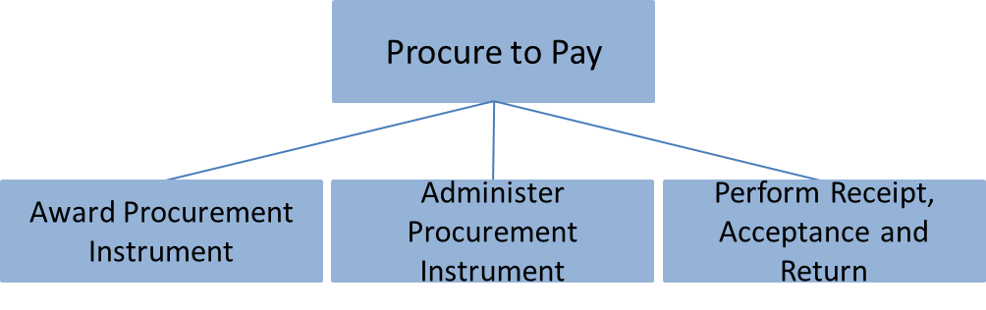
Architecture Model Notional Example: A Second E2E Hierarchy: P2P
Meta-Model
Architecture Models
E2E Capability Hierarchies
Functional Activity Hierarchy
Second E2E Hierarchy: P2P

Slide 14




Architecture Model Notional Example: Second E2E Hierarchy and Federation Level Context
Meta-Model
Architecture Models
P2P E2E Hierarchy Context
E2E Capability Hierarchies
Functional Activity Hierarchy
P2P L1 E2E Federation Level
P2P L2 E2E Federation Level

Slide 15

Architecture Model Notional Example: Operational Activity in Two Different E2E Contexts
Meta-Model
Architecture Models
E2E Capability Hierarchies
Functional Activity Hierarchy
Participates in two E2E Hierarchies: P2S and P2P (both at Level 2)
Activity in Second E2E Context: P2P L2
Only valid in P2S E2E Hierarchy Context
Activity in E2E Context: P2S L2

Slide 16
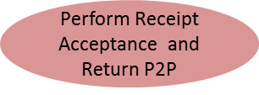
Architecture Model Notional Example: Operational Activity in a L1 E2E Context
Meta-Model
Architecture Models
E2E Capability Hierarchies
Functional Activity Hierarchy
Activity in E2E Context: P2P L1

Slide 17
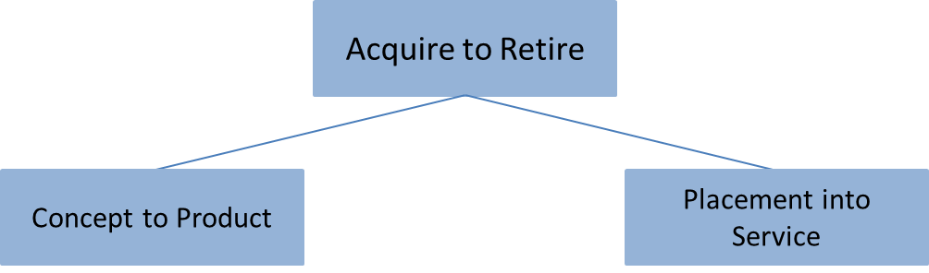
Architecture Model Notional Example: A Third E2E Hierarchy: A2R
Architecture Models
E2E Capability Hierarchies
Functional Activity Hierarchy
Third E2E Hierarchy: A2R

Slide 18



Architecture Model Notional Example: Third E2E Hierarchy and Federation Level Context
Architecture Models
E2E Capability Hierarchies
A2R E2E Hierarchy Context
Functional Activity Hierarchy
A2R L1 E2E Federation Level
A2RL2 E2E Federation Level

Slide 19
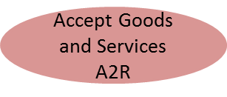
Architecture Model Notional Example: Operational Activity in Three Different E2E Contexts
Architecture Models
E2E Capability Hierarchies
Functional Activity Hierarchy
Activity in Third E2E Context: A2R L2
Participates in three E2E Hierarchies: P2S, P2P and A2R (all at level 2)
Activity in Second E2E Context: P2P L2
Still only valid in P2S E2E Hierarchy Context
Activity in E2E Context: P2S L2

Slide 20


Architecture Model Notional Example: Operational Activity in Two Different L1 E2E Contexts
Architecture Models
E2E Capability Hierarchies
Functional Activity Hierarchy
Participates in two E2E Hierarchies: P2P and A2R (both at level 1)
Activity in Second E2E Context: A2R L1
Activity in E2E Context: P2P L1

Slide 21
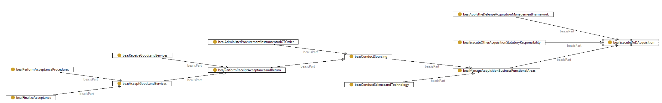
BEOF Architecture Model Example: BEA Operational Activity Node Tree
Functional Activity Hierarchy

Slide 22
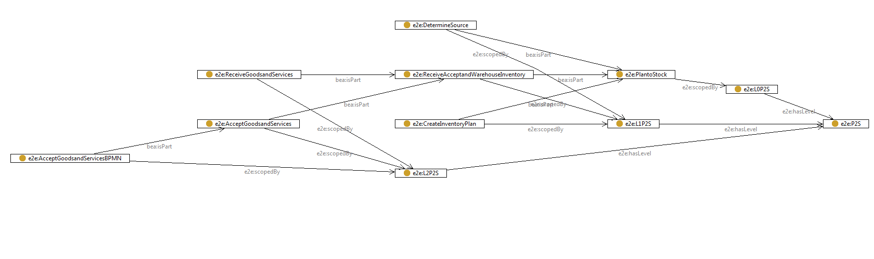
BEOF Architecture Model Example: E2E Hierarchy and Federation Level Context
Functional Activity Hierarchy
E2E Capability Hierarchy (P2S)
P2S L0 E2E Federation Level
P2S E2E Hierarchy Context
P2S L1 E2E Federation Level
P2S L2 E2E Federation Level

Slide 23
BEOF Architecture Model Example: BPMN Tasks Extend the BEA Activity Node Tree
Functional Activity Hierarchy
Task within the BPMN model
E2E Capability Hierarchy (P2S)
P2S L0 E2E Federation Level
P2S E2E Hierarchy Context
P2S L1 E2E Federation Level
P2S L2 E2E Federation Level
E2E Segment represented by a BPMN model (BPMN Segment):
Illustrated here as a BEA ‘level 2 extension’, but …
could also be a Component level 3 operational process model

Slide 24
BEOF Architecture Model Example: Activity in E2E Context
Functional Activity Hierarchy
‘Activity in E2E Context’ makes these Associations
E2E Capability Hierarchy (P2S)
P2S L0 E2E Federation Level
P2S E2E Hierarchy Context
P2S L1 E2E Federation Level
P2S L2 E2E Federation Level

Slide 25
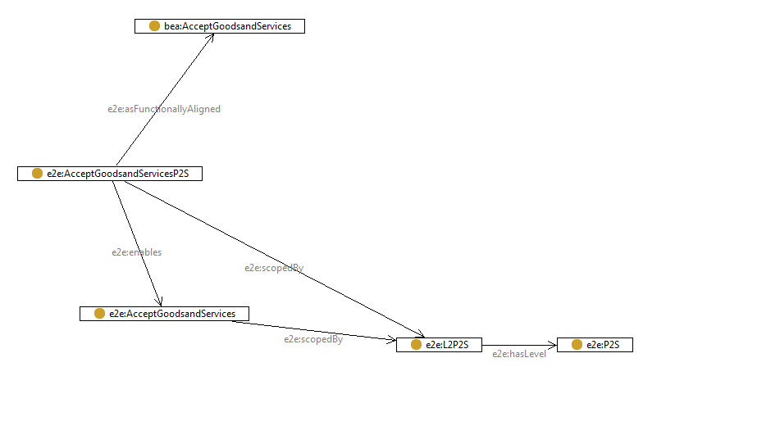
BEOF Architecture Model Example: Activity in E2E Context
Functional Activity Hierarchy
Activity in E2E Context: P2S L2
E2E Capability Hierarchy (P2S)
P2S E2E Hierarchy Context
P2S L2 E2E Federation Level

